Slide 1
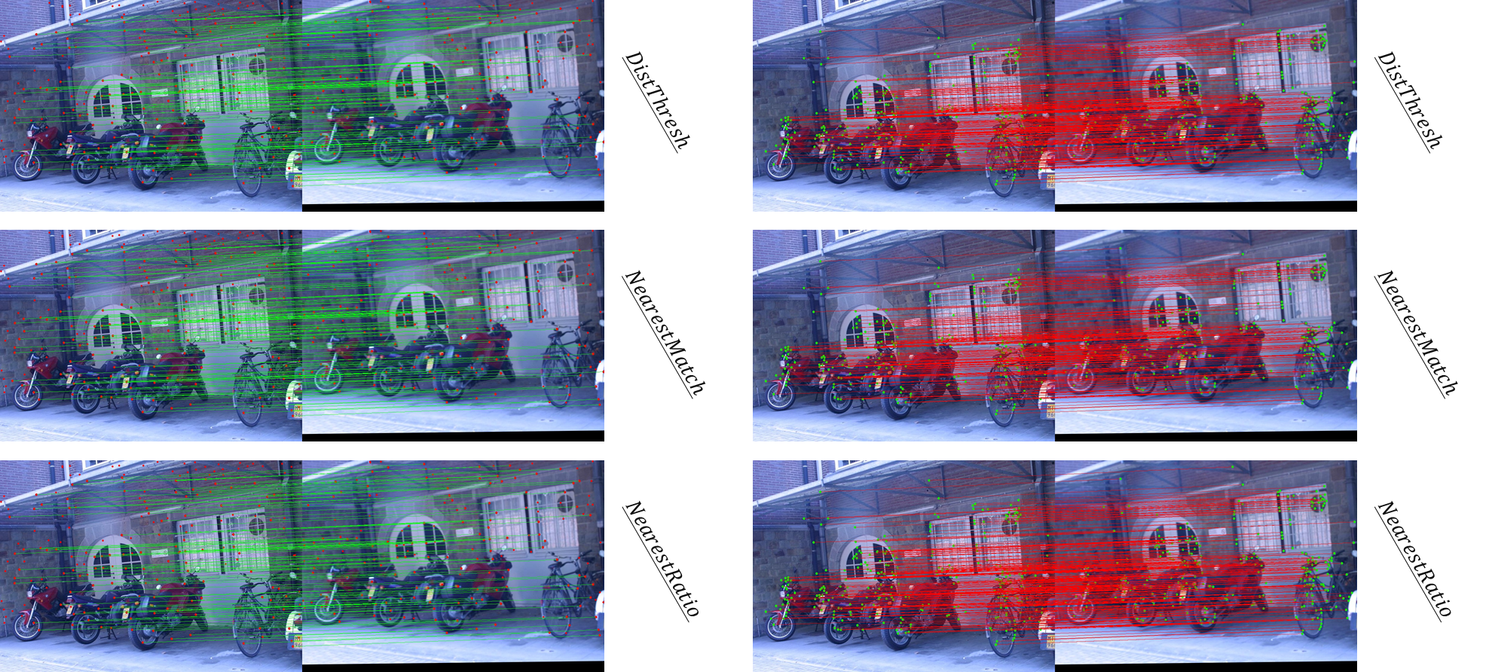
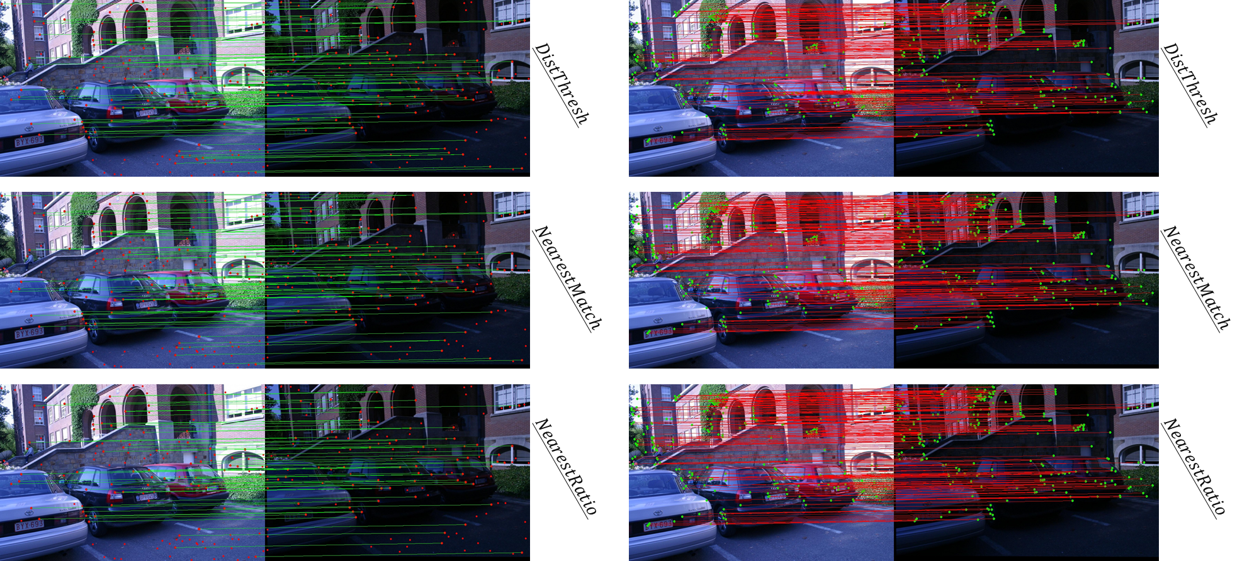
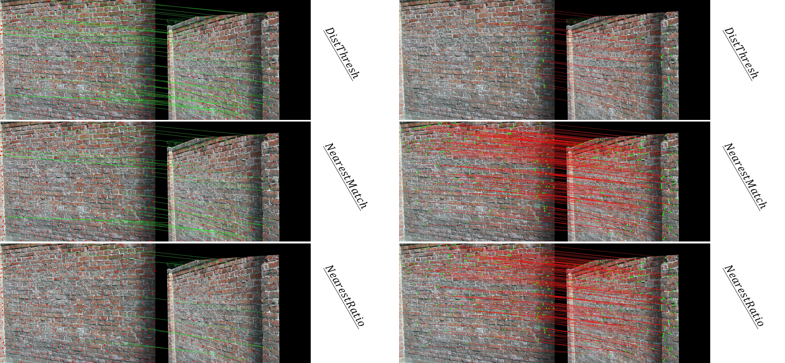


HOMEWORK 4B
ECE/CS 8690 2302 Computer Vision
Bikes
Img 1 – 3
①
$$Moving Object Detection using$$
$$Simple Background Subtraction$$
Xuanbo Miao
14422044
xmiao@mail.missouri.edu
Leuven
Img 1 – 6
②
Abstract
This assignment focuses on implementing a basic pipeline for feature detection, description, and matching. The first step is feature detection, which involves computing the autocorrelation matrix and a scalar feature detection measure using a formula discussed in class. The detected feature points are then shown in the image and included in the report. The second step is feature matching and evaluation, which involves defining and describing a feature descriptor and using it to match features using three different strategies. The performance of the feature matching is evaluated using transformation/homography matrices provided with the data.
Wall
Img 2 – 4
③

Slide 2
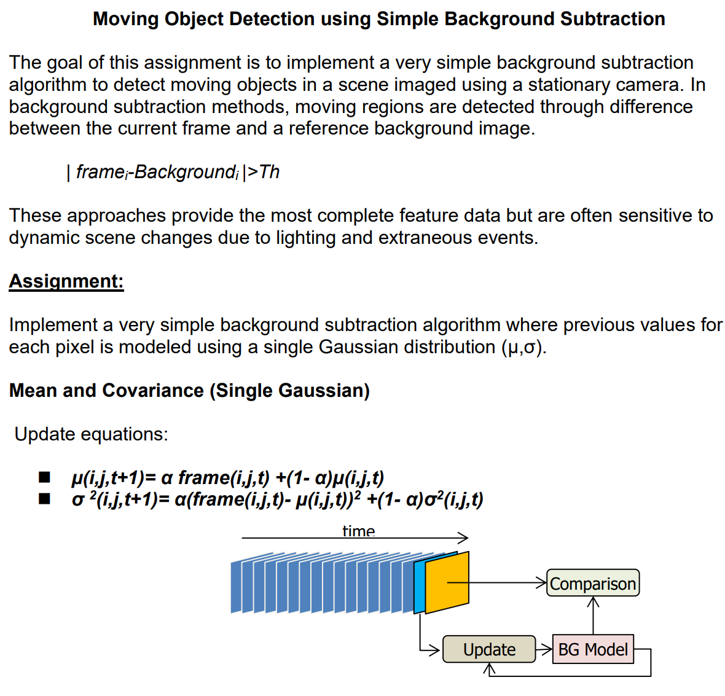
Introduction
In the field of computer vision, detecting and tracking moving objects in video streams is a crucial task with numerous applications, including surveillance, traffic monitoring, and robotic navigation. One popular technique for accomplishing this is through background subtraction, where the objective is to identify the foreground, consisting of moving objects, by distinguishing it from the static background.
In this assignment, we will implement a simple background subtraction algorithm using a single Gaussian model for each pixel to detect moving objects in a video sequence captured by a stationary camera. The algorithm involves maintaining a background model, classifying pixels as foreground or background based on their differences from the background model, and updating the background model with new frames over time.
We will experiment with different learning rates and matching thresholds to analyze the performance of the algorithm in detecting moving objects. The test data for this assignment is taken from the CAVIAR1 dataset, and the results will be evaluated using frames 5, 100, and 400. The assignment will be assessed on the basis of the source code, visualizations, and interpretations of the results.

Slide 3
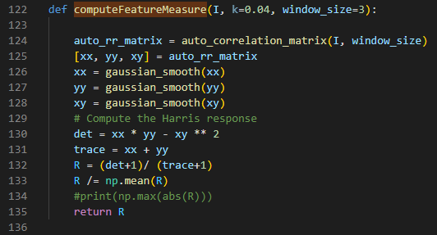
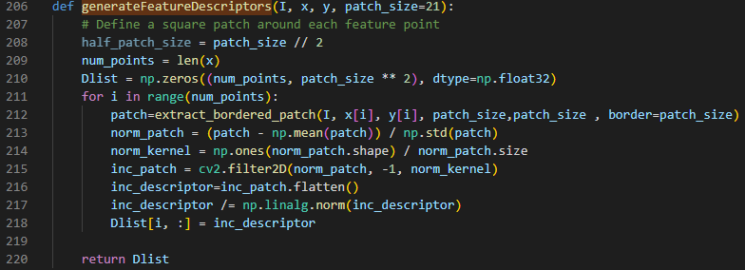
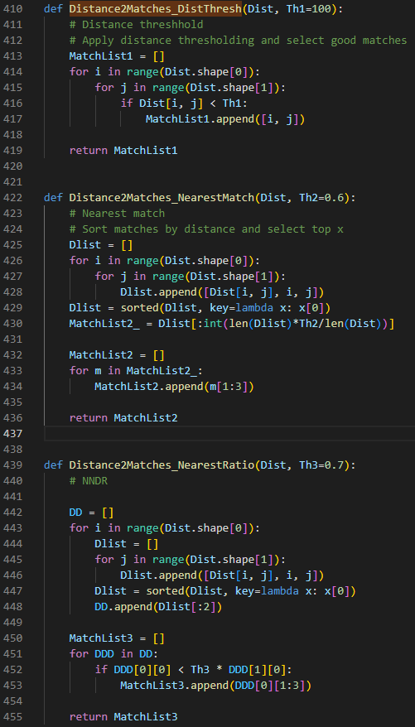
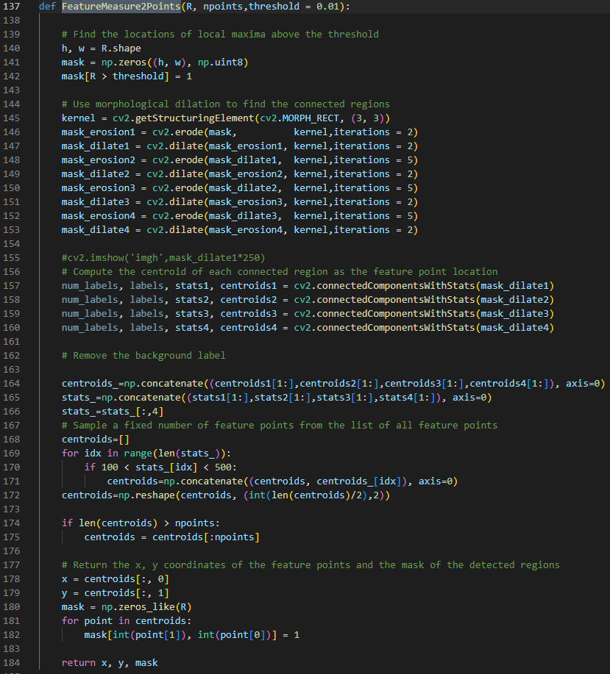
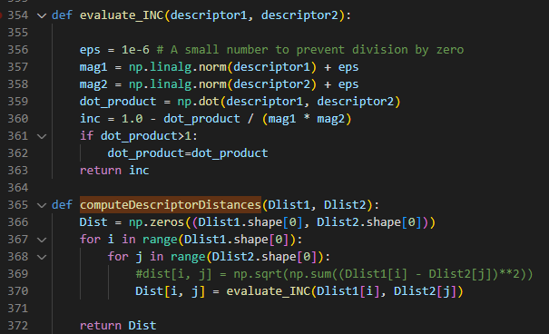
Functions as required
5. Function [MatchList1]=Distance2Matches_DistThresh(Dist,Th1)
Function [MatchList2]=Distance2Matches_NearestMatch(Dist,Th2)
Function [MatchList3]=Distance2Matches_NearestRatio(Dist,Th3
1. function [R]=computeFeatureMeasure(I,parameters)
3. function [DList]=generateFeatureDescriptors(I,x,y)
2. function [x,y,mask]=FeatureMeasure2Points(R,npoints)
4. function [Dist]=computeDescriptorDistances(Dlist1,Dlist2)

Slide 4
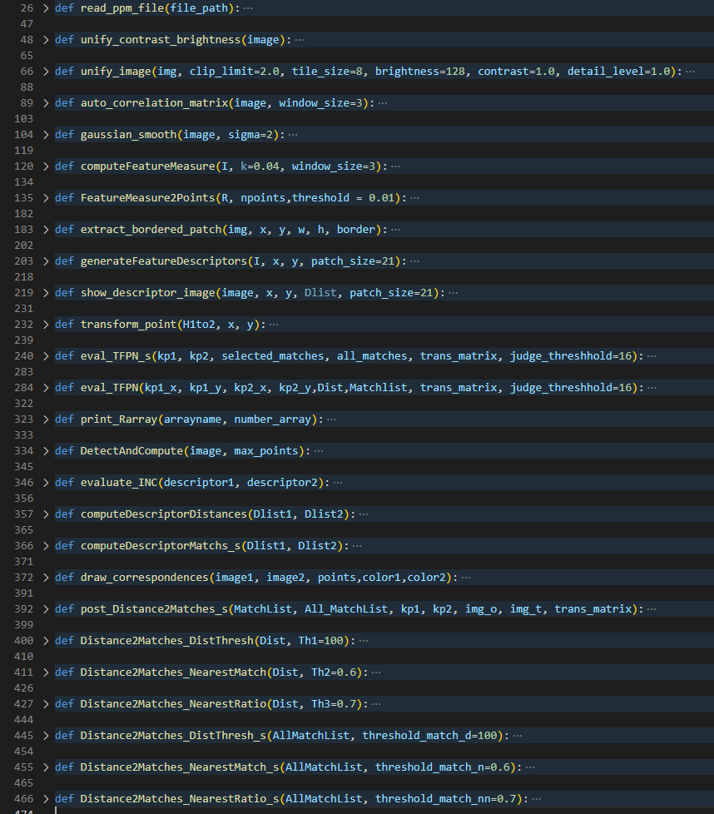
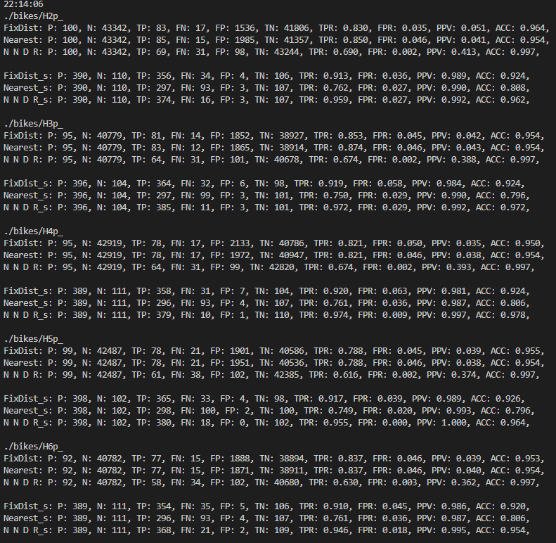
All Coded Functions
Output dialog of ‘bikes’ img 1 –img 3

Slide 5
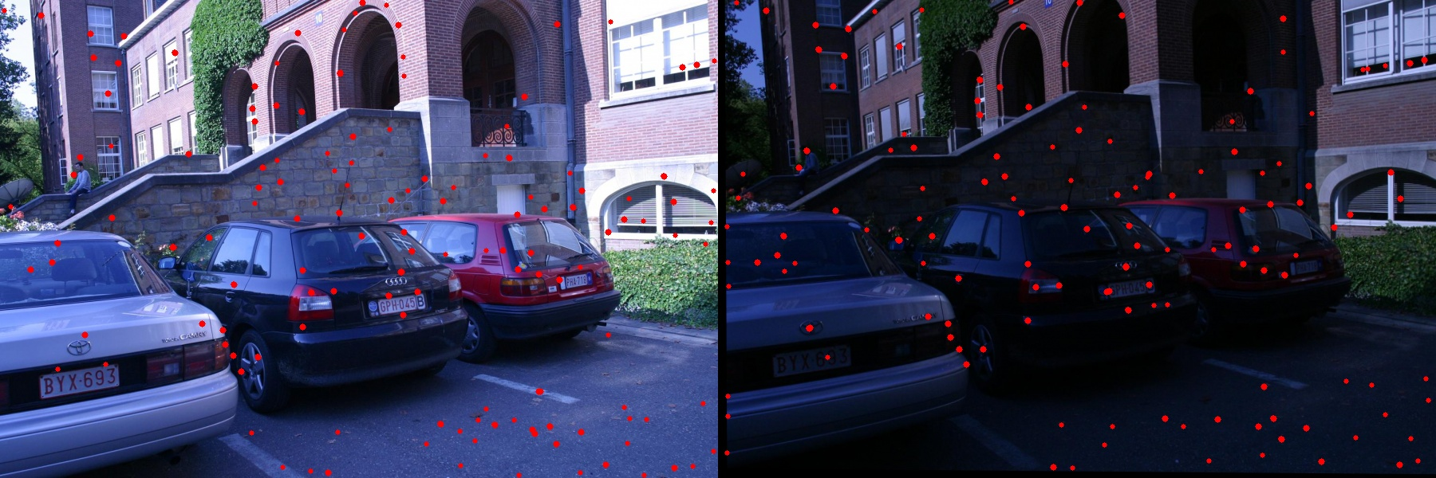

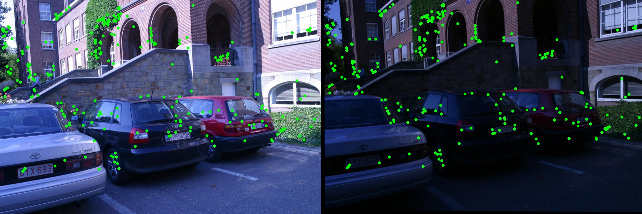
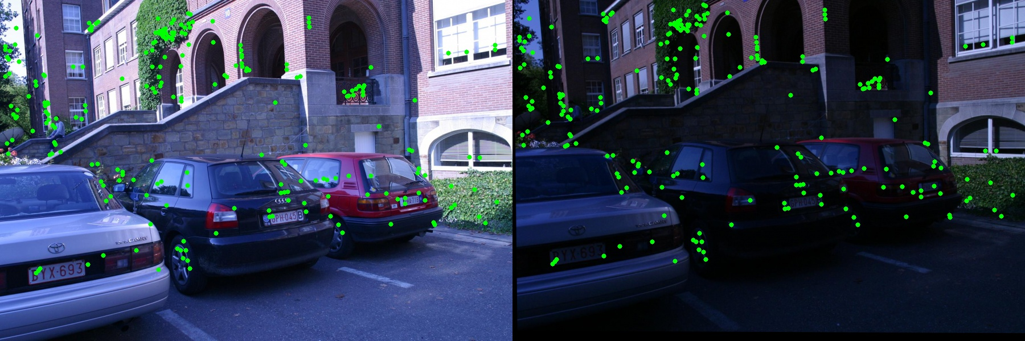






Report 1.1. Feature detection-leuven
Specific: Leuven img 1 –img 6
𝑯𝒂𝒓𝒎𝒐𝒏𝒊𝒄 𝒎𝒆𝒂𝒏 (All self coded, except basic np. cv2. library)
$$Img2$$
$Img4 H$1to4p
$Img4 H$1to6p
Using SIFT (involve using a part of cv2.sift library functions)
$$Img2$$
$Img4 H$1to4p
$Img4 H$1to6p

Slide 6
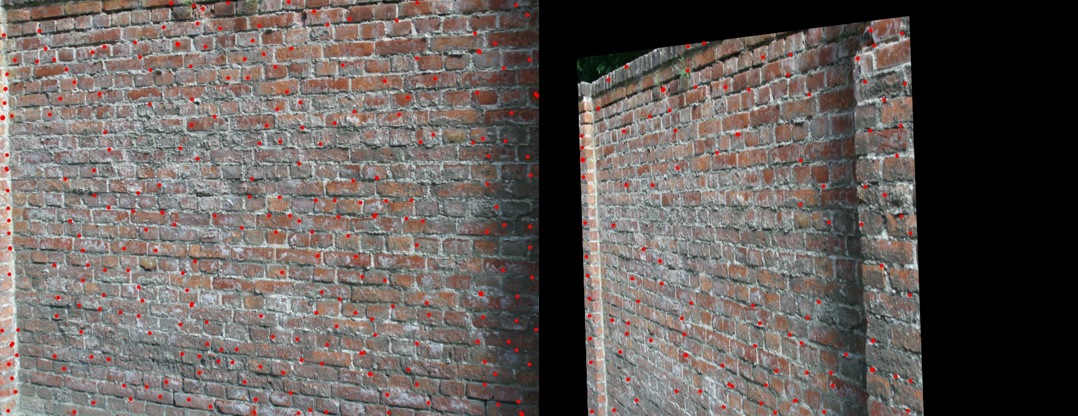
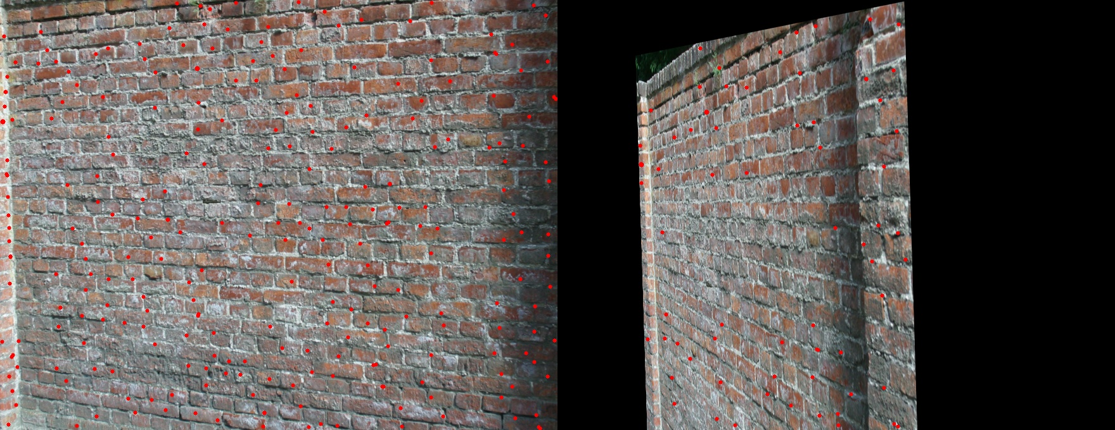
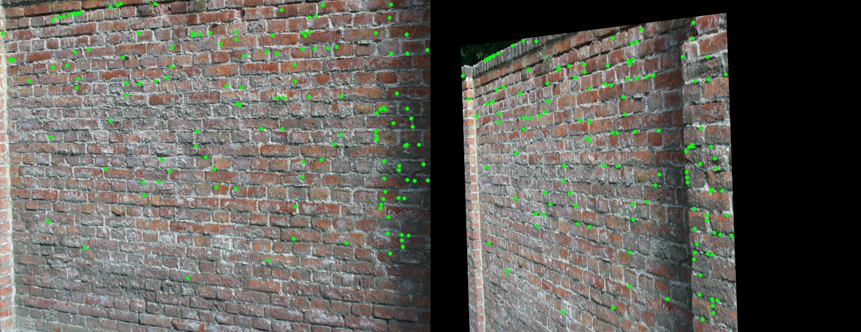
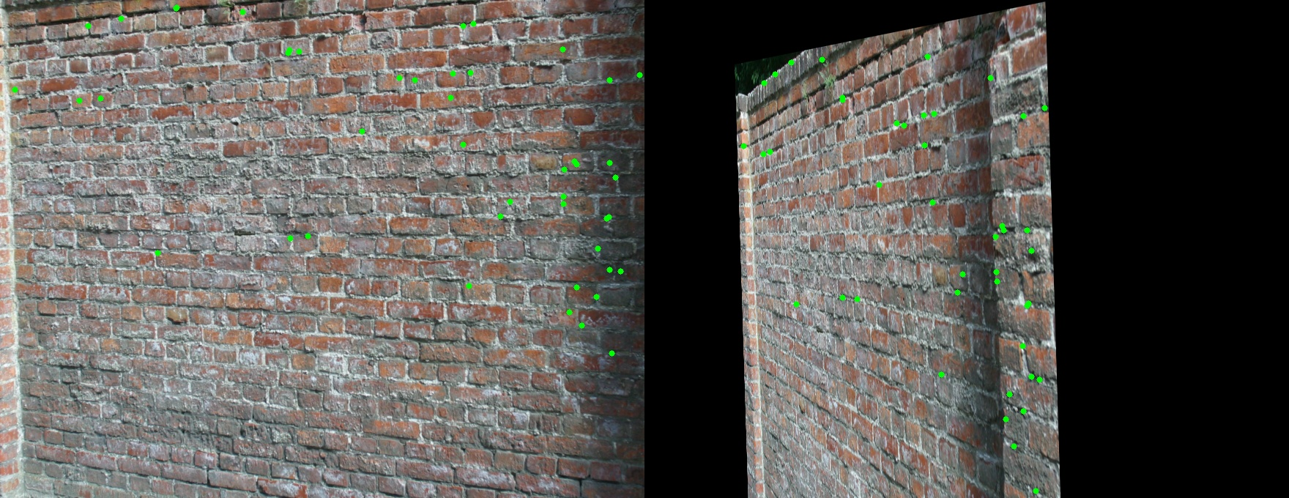
Report 1.2. Feature detection-wall
Specific: wall img 2 –img 4
𝑯𝒂𝒓𝒎𝒐𝒏𝒊𝒄 𝒎𝒆𝒂𝒏 (All self coded, except basic np. cv2. library)
$$Img2$$
$Img4 H$1to4p
$Img4 H$1to6p
Using SIFT (involve using a part of cv2.sift library functions)
$$Img2$$
$Img4 H$1to4p
$Img4 H$1to6p

Slide 7

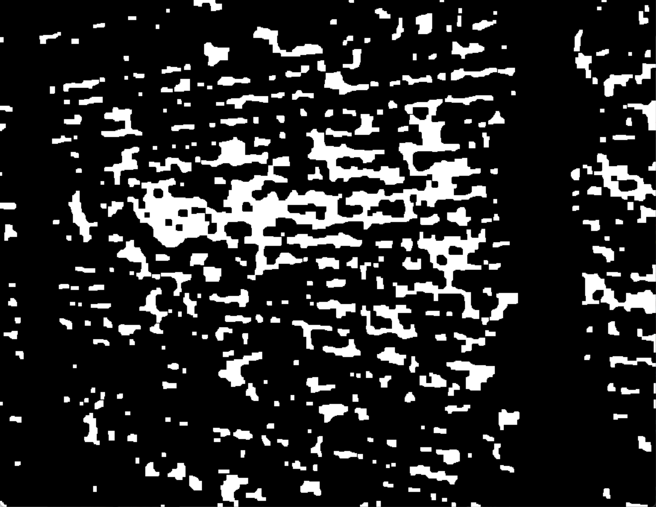
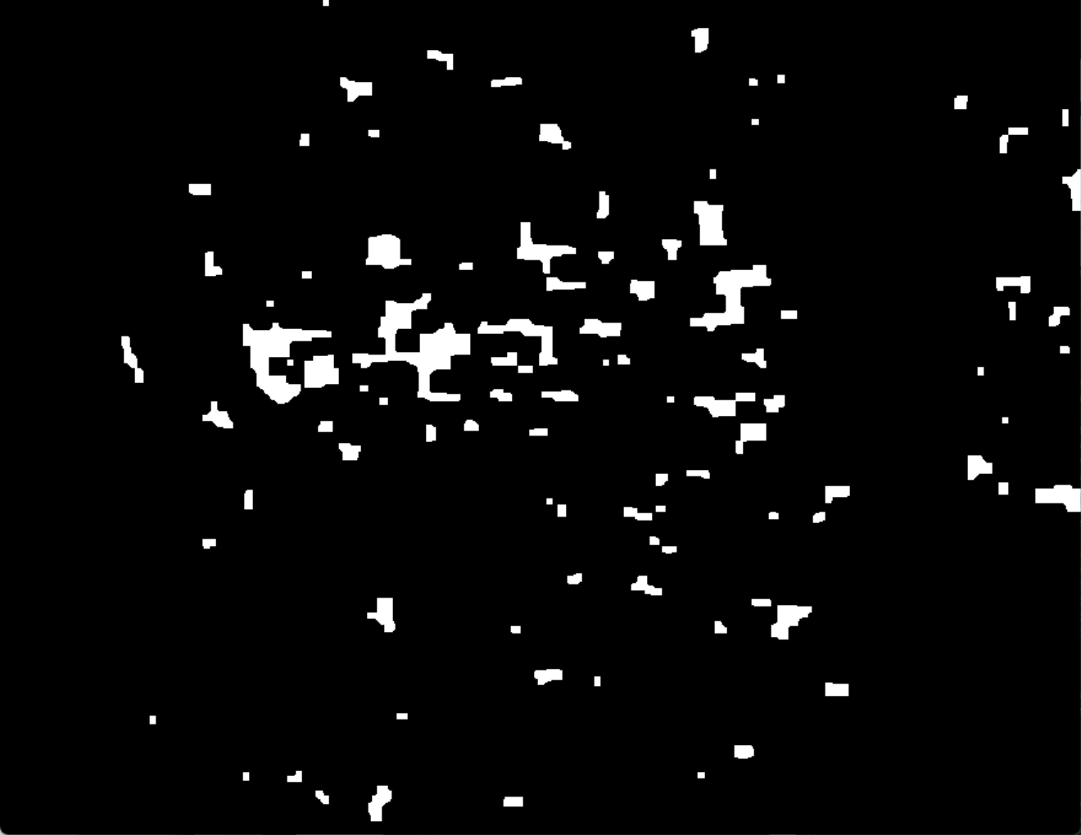
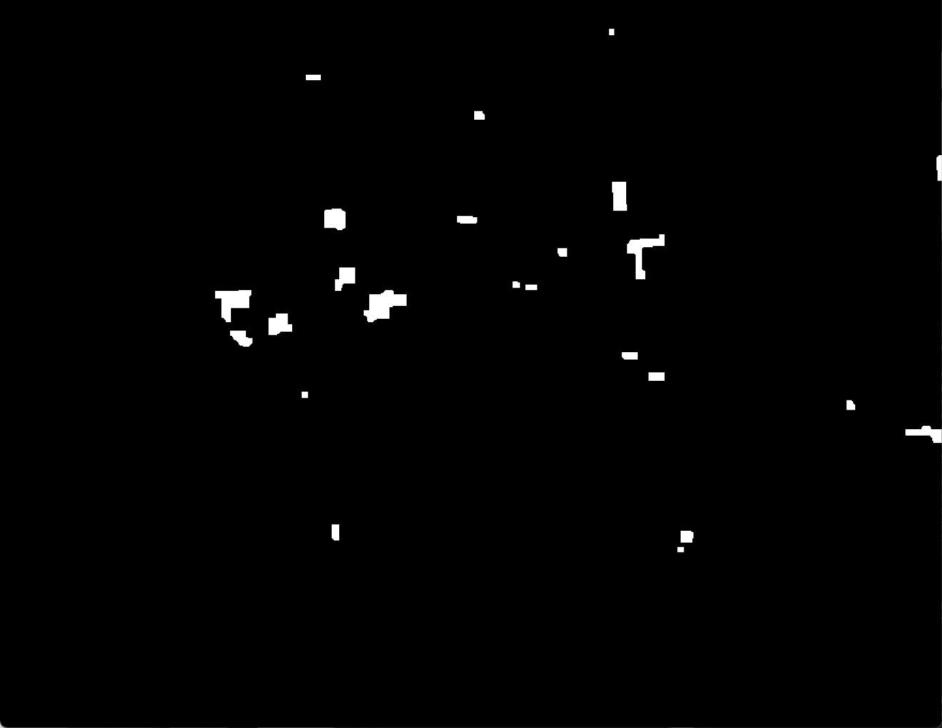
Report 1. Feature detection-Highlight
I use Multi Stages Erosion and Dilate, to fit different detail-scale levels of the R matrix
mask_erosion1 = cv2.erode(mask, kernel,iterations = 2)
mask_dilate1 = cv2.dilate(mask_erosion1, kernel,iterations = 2)
mask_erosion2 = cv2.erode(mask_dilate1, kernel,iterations = 5)
mask_dilate2 = cv2.dilate(mask_erosion2, kernel,iterations = 2)
mask_erosion3 = cv2.erode(mask_dilate2, kernel,iterations = 5)
mask_dilate3 = cv2.dilate(mask_erosion3, kernel,iterations = 2)
mask_erosion4 = cv2.erode(mask_dilate3, kernel,iterations = 5)
mask_dilate4 = cv2.dilate(mask_erosion4, kernel,iterations = 2)

Slide 8
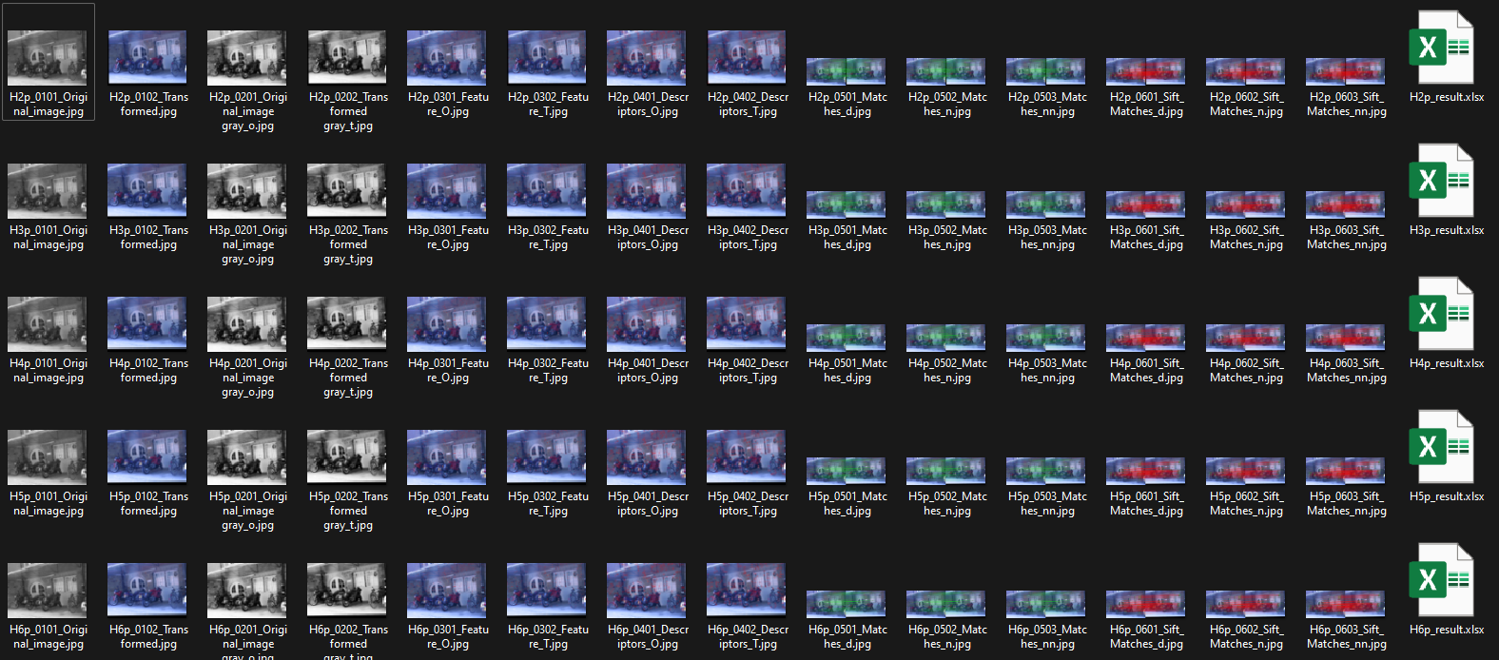
Report 2.1. Feature matching and evaluation-Bikes

Slide 9
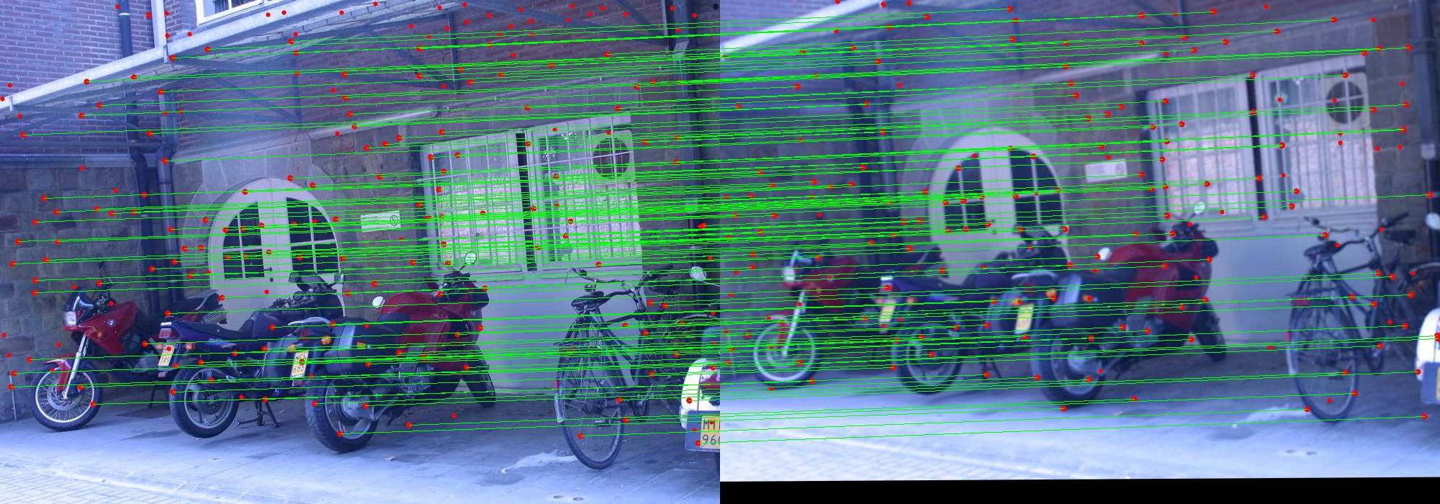
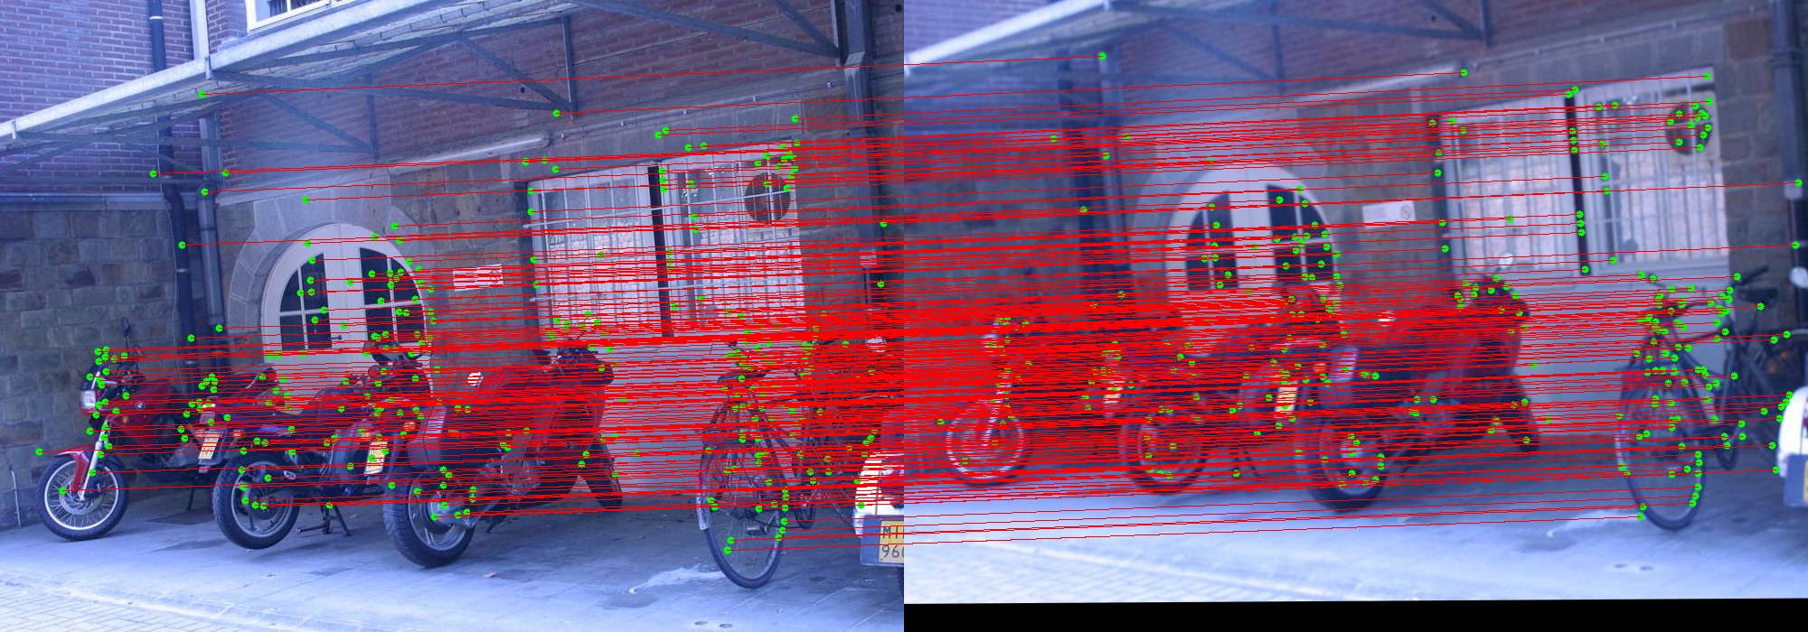

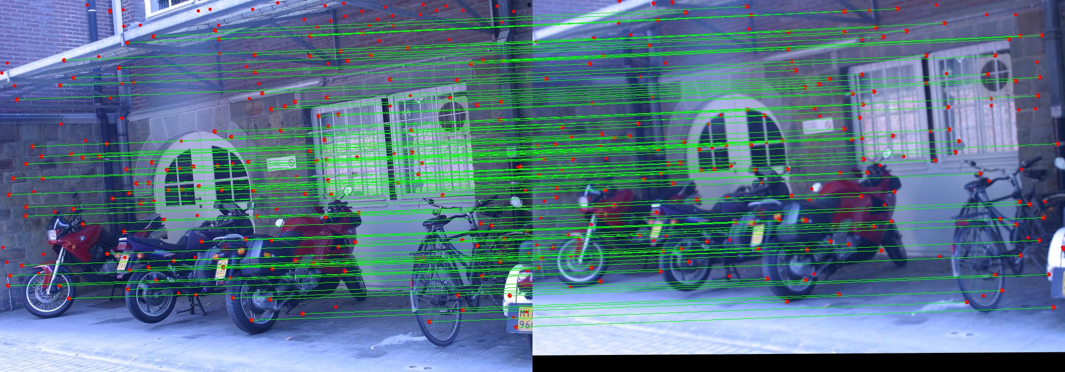

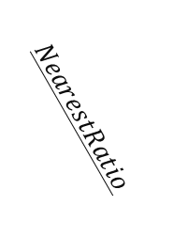

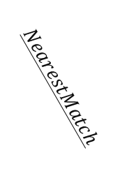
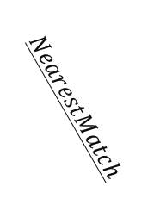


Report 2.1. Feature matching and evaluation-Bikes
Specific: H1to4p over img 1 –img 3
𝑯𝒂𝒓𝒎𝒐𝒏𝒊𝒄 𝒎𝒆𝒂𝒏 (All self coded, except basic np. cv2. library)
Using SIFT (involve using a part of cv2.sift library functions)
$$DistThresh$$
$$DistThresh$$
$$NearestMatch$$
$$NearestMatch$$
$$NearestRatio$$
$$NearestRatio$$
* Red Dots are Keypoints, Green Lines are Ture Positive Matches, bad results are not shown (they are Red Dots without matching).
* Green Dots are Keypoints, Red Lines are Ture Positive Matches, bad results are not shown (they are Red Dots without matching).

Slide 10
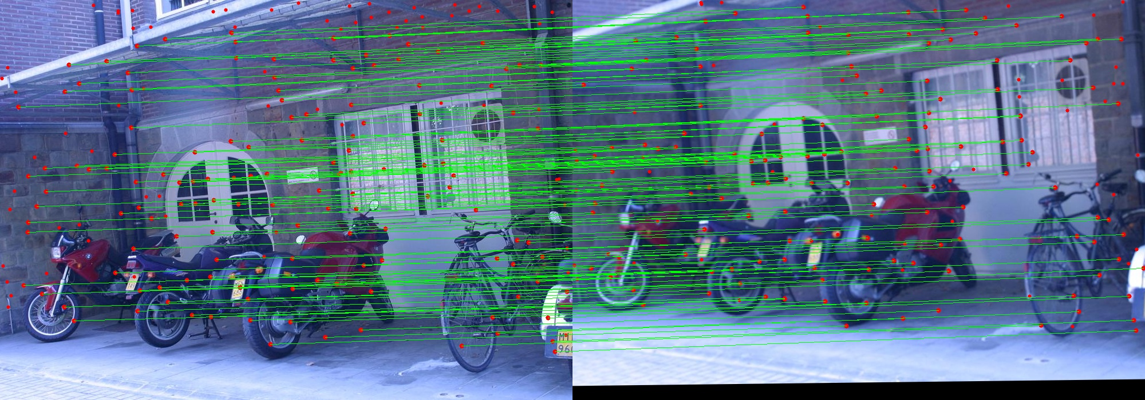
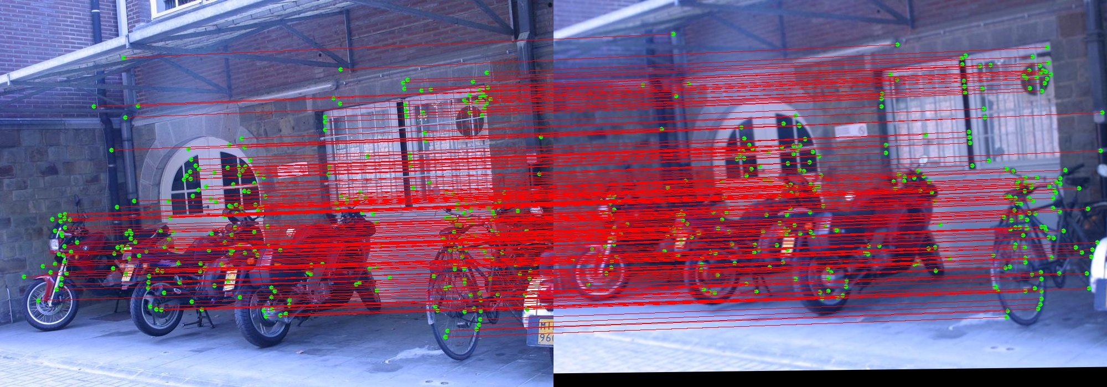
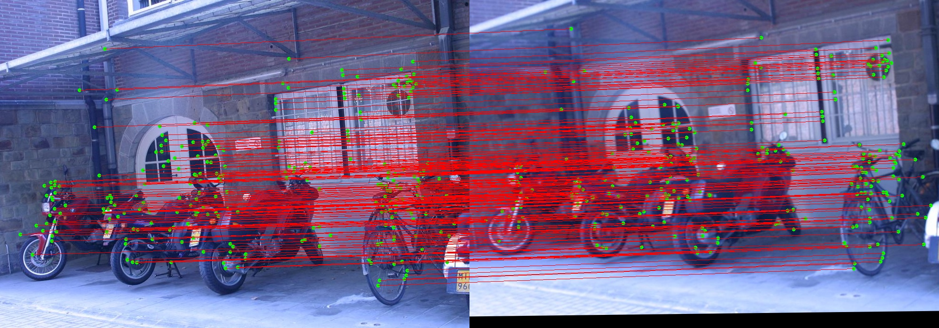
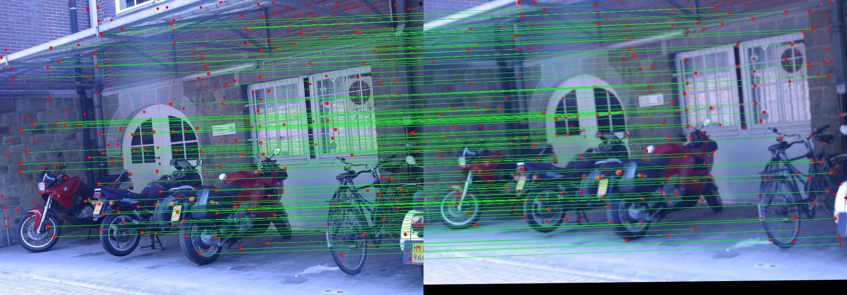

Report 2.1. Feature matching and evaluation-Bikes
Specific: H1to6p over img 1 –img 3
𝑯𝒂𝒓𝒎𝒐𝒏𝒊𝒄 𝒎𝒆𝒂𝒏 (All self coded, except basic np. cv2. library)
Using SIFT (involve using a part of cv2.sift library functions)
$$DistThresh$$
$$DistThresh$$
$$NearestMatch$$
$$NearestMatch$$
$$NearestRatio$$
$$NearestRatio$$
* Red Dots are Keypoints, Green Lines are Ture Positive Matches, bad results are not shown (they are Red Dots without matching).
* Green Dots are Keypoints, Red Lines are Ture Positive Matches, bad results are not shown (they are Red Dots without matching).

Slide 11
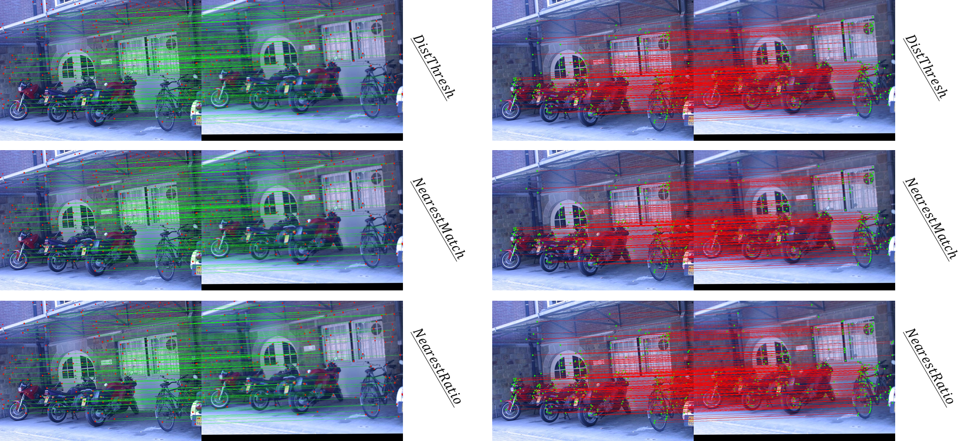
Report 2.1. Feature matching and evaluation-Bikes
Specific: H1to4p over img 1 –img 3
Specific: H1to6p over img 1 –img 3

Slide 12
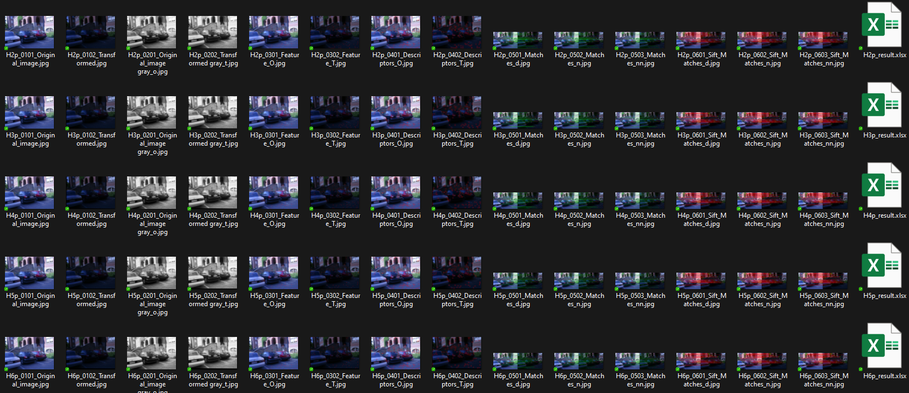
Report 2.2. Feature matching and evaluation-Leuven

Slide 13
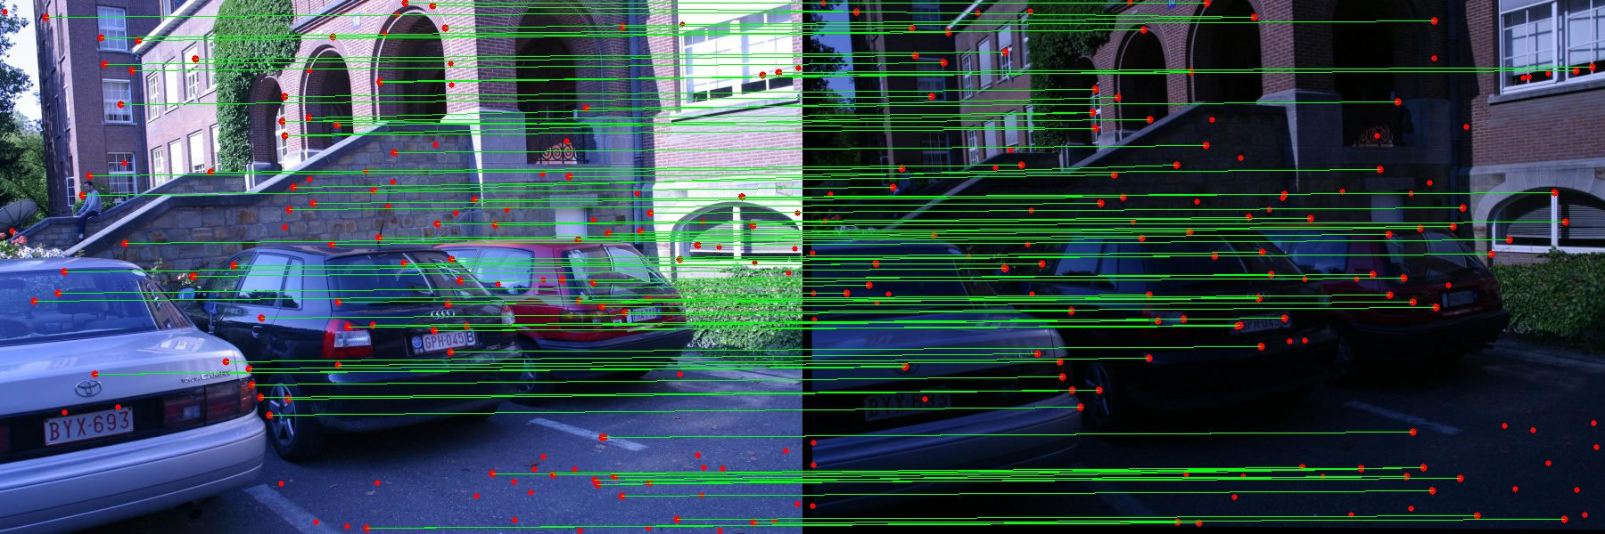
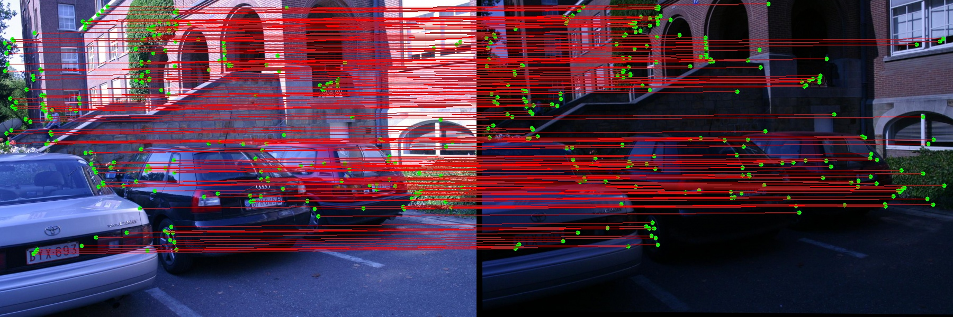
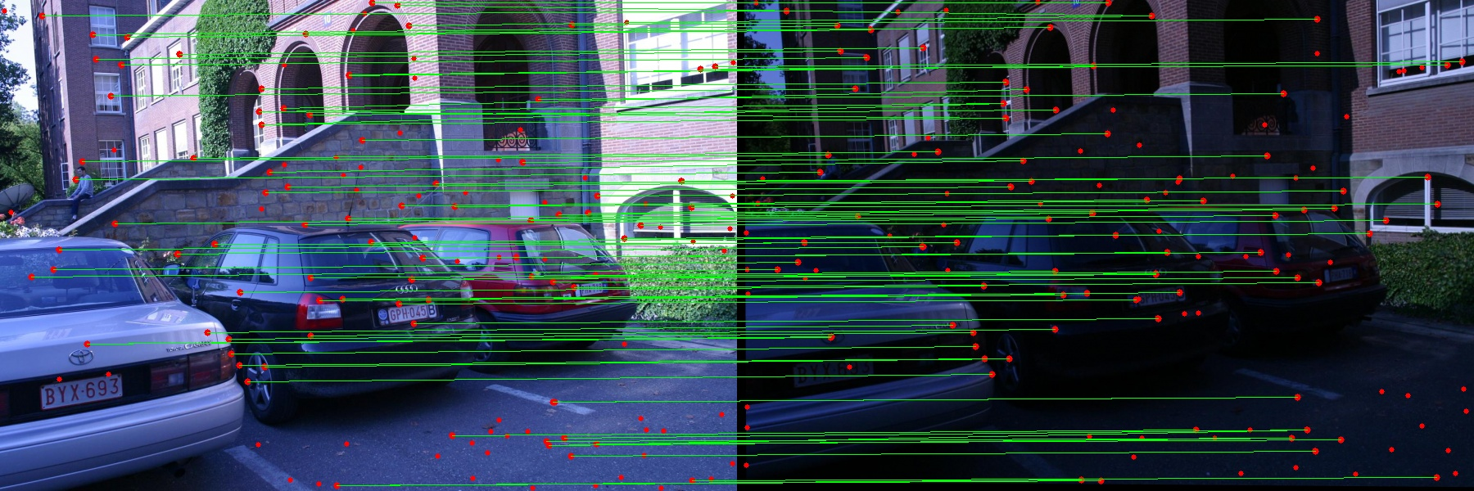
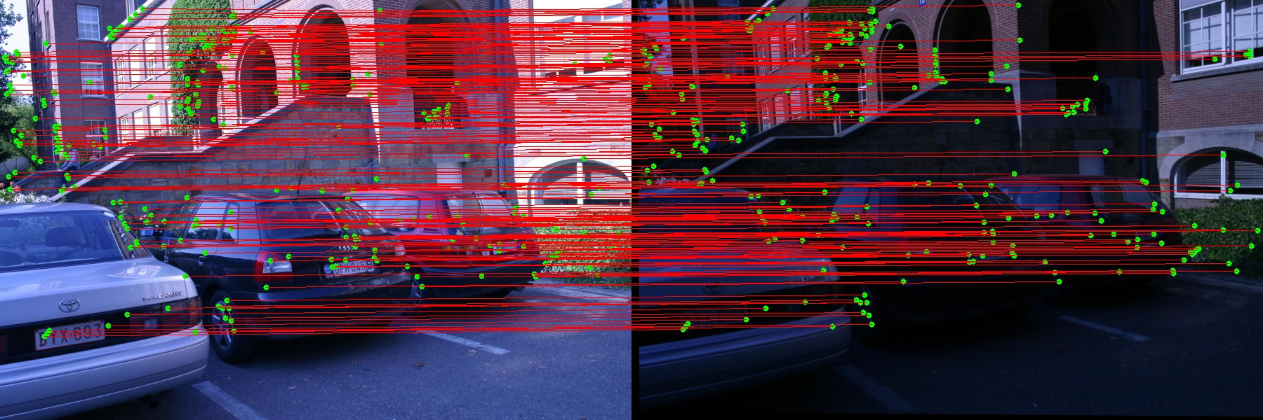
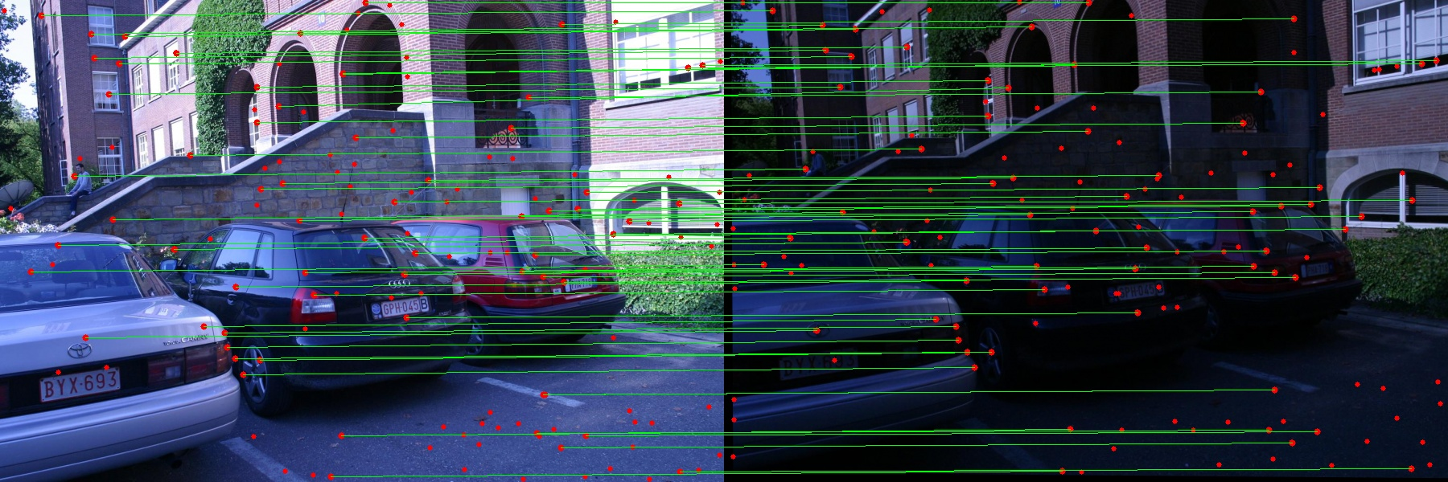

Report 2.2. Feature matching and evaluation-Leuven
Specific: H1to4p over img 1 –img 6
𝑯𝒂𝒓𝒎𝒐𝒏𝒊𝒄 𝒎𝒆𝒂𝒏 (All self coded, except basic np. cv2. library)
Using SIFT (involve using a part of cv2.sift library functions)
$$DistThresh$$
$$DistThresh$$
$$NearestMatch$$
$$NearestMatch$$
$$NearestRatio$$
$$NearestRatio$$
* Red Dots are Keypoints, Green Lines are Ture Positive Matches, bad results are not shown (they are Red Dots without matching).
* Green Dots are Keypoints, Red Lines are Ture Positive Matches, bad results are not shown (they are Red Dots without matching).

Slide 14
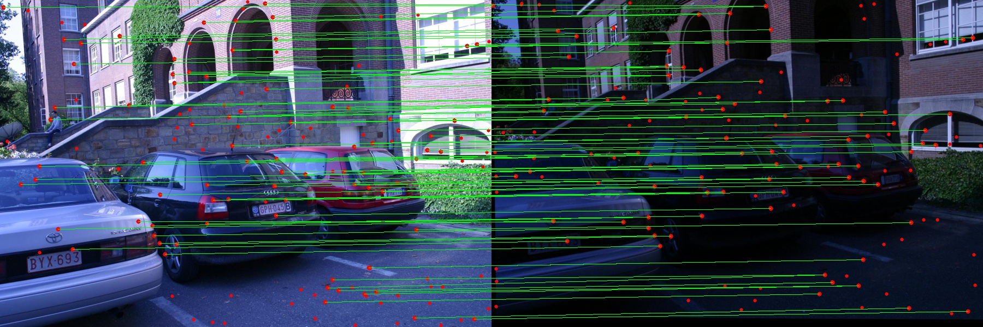

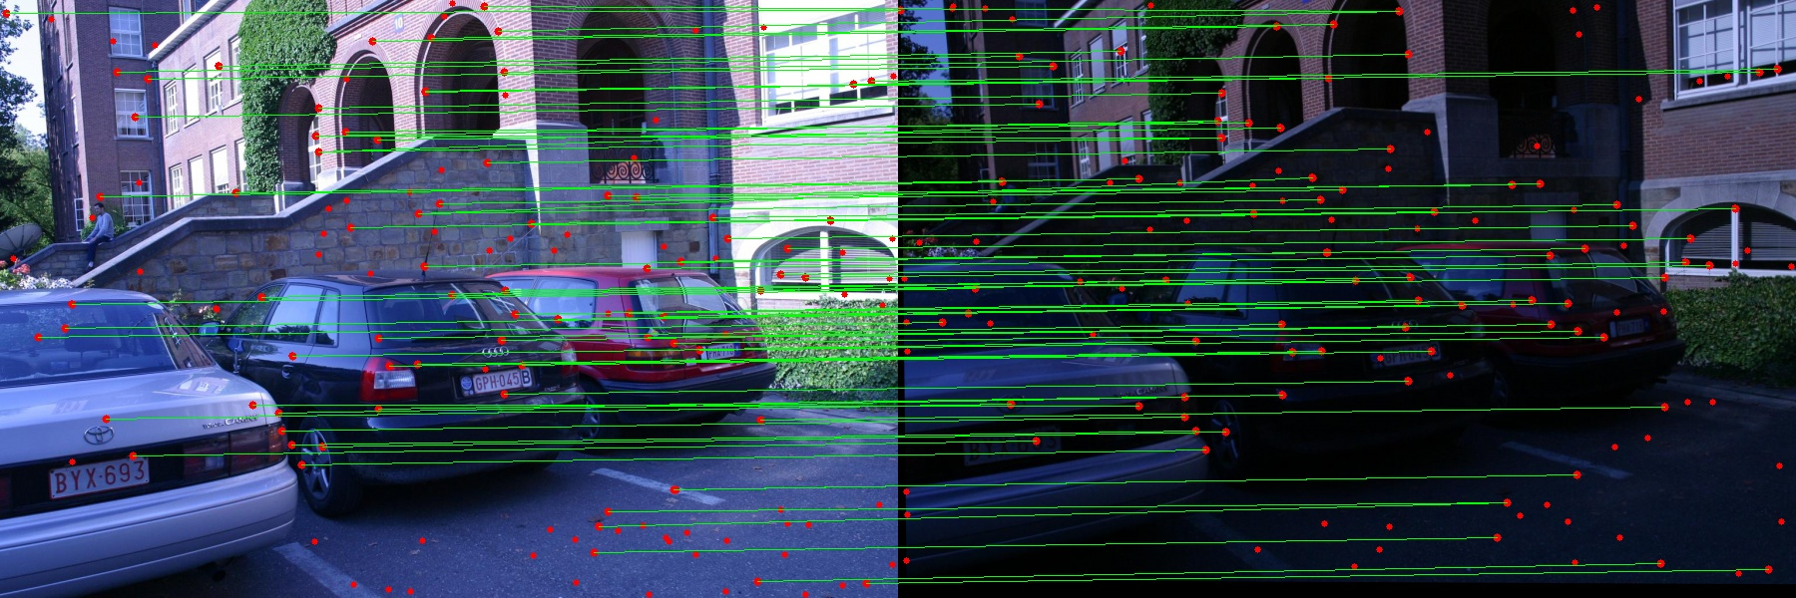

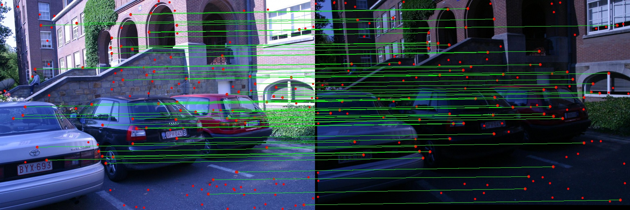

Report 2.2. Feature matching and evaluation-Leuven
Specific: H1to6p over img 1 –img 6
𝑯𝒂𝒓𝒎𝒐𝒏𝒊𝒄 𝒎𝒆𝒂𝒏 (All self coded, except basic np. cv2. library)
Using SIFT (involve using a part of cv2.sift library functions)
$$DistThresh$$
$$DistThresh$$
$$NearestMatch$$
$$NearestMatch$$
$$NearestRatio$$
$$NearestRatio$$
* Red Dots are Keypoints, Green Lines are Ture Positive Matches, bad results are not shown (they are Red Dots without matching).
* Green Dots are Keypoints, Red Lines are Ture Positive Matches, bad results are not shown (they are Red Dots without matching).

Slide 15
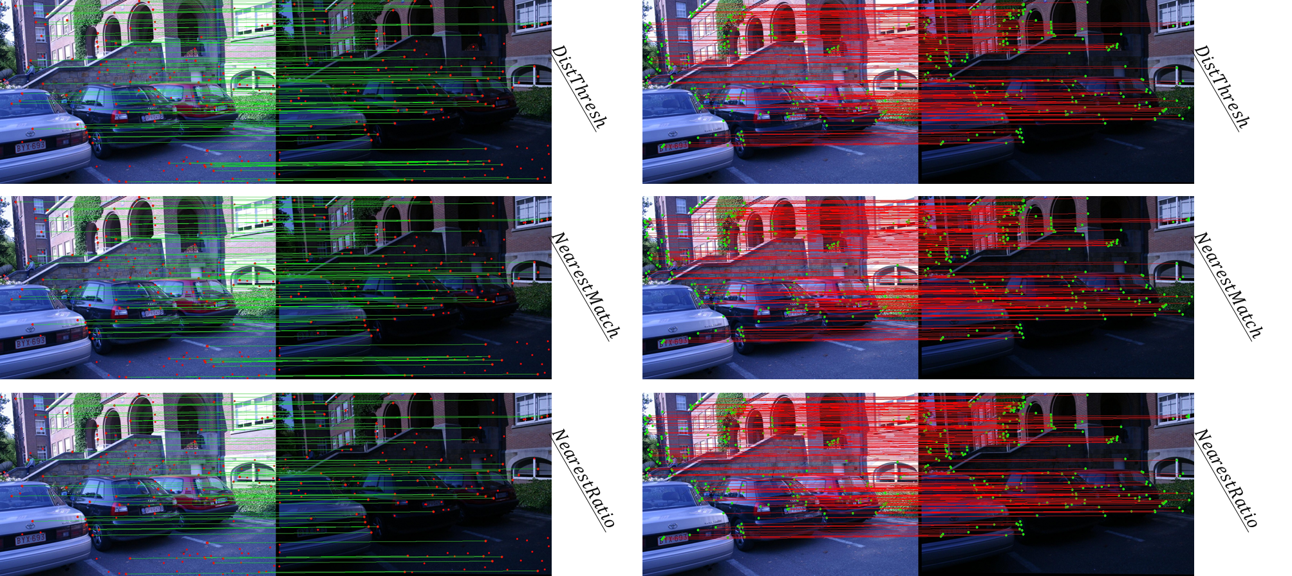
Report 2.2. Feature matching and evaluation-Leuven
Specific: H1to4p over img 1 –img 6
Specific: H1to6p over img 1 –img 6

Slide 16
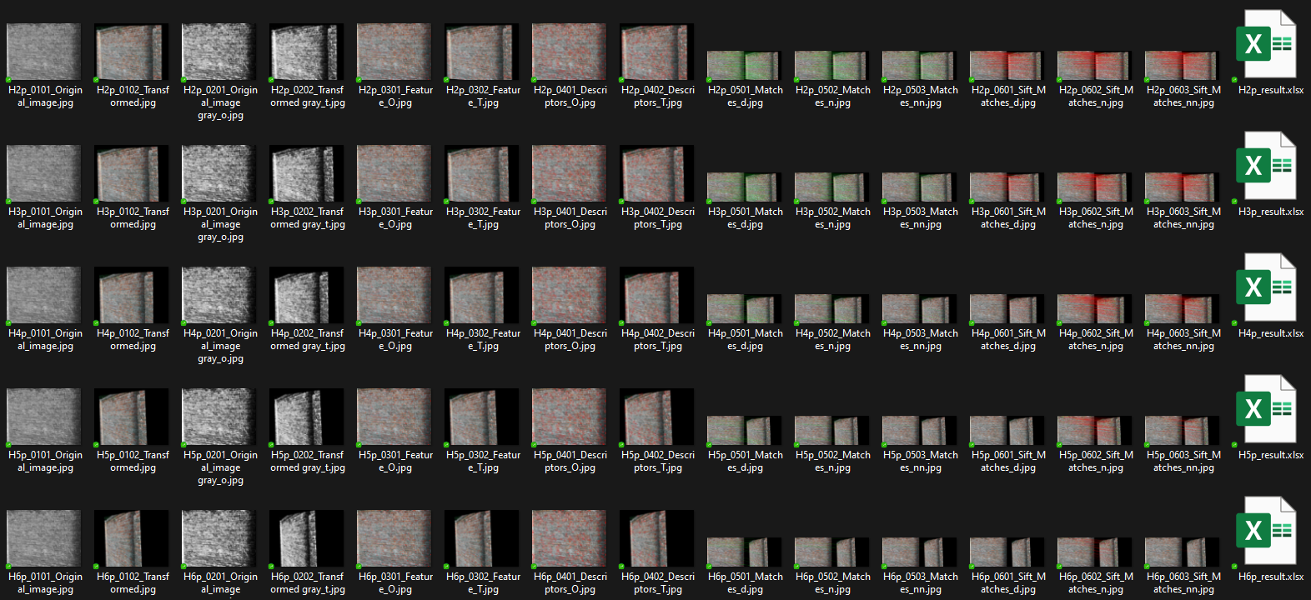
Report 2.3. Feature matching and evaluation-Wall

Slide 17
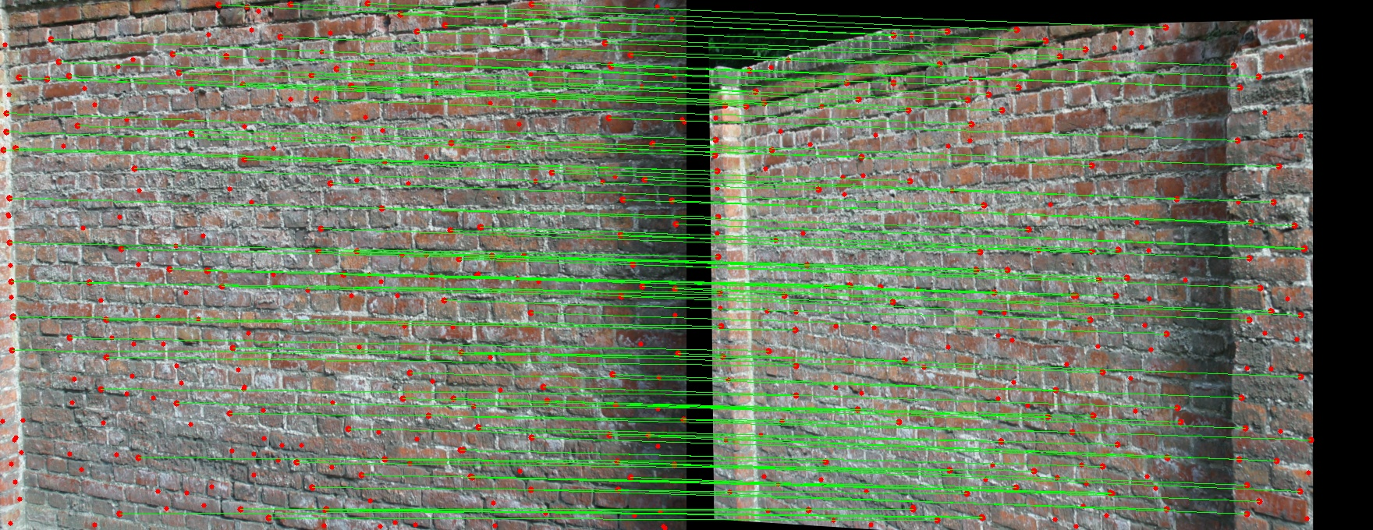
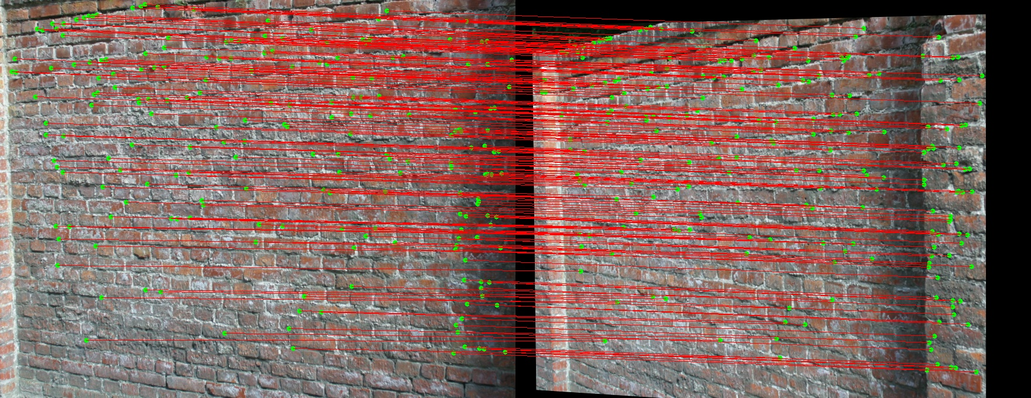
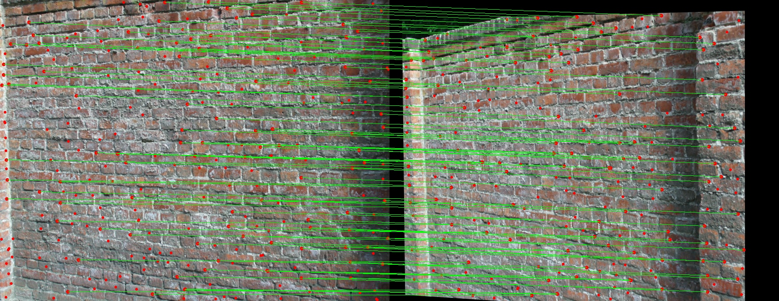
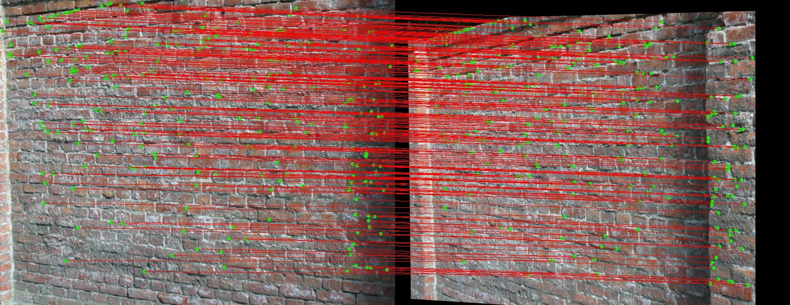
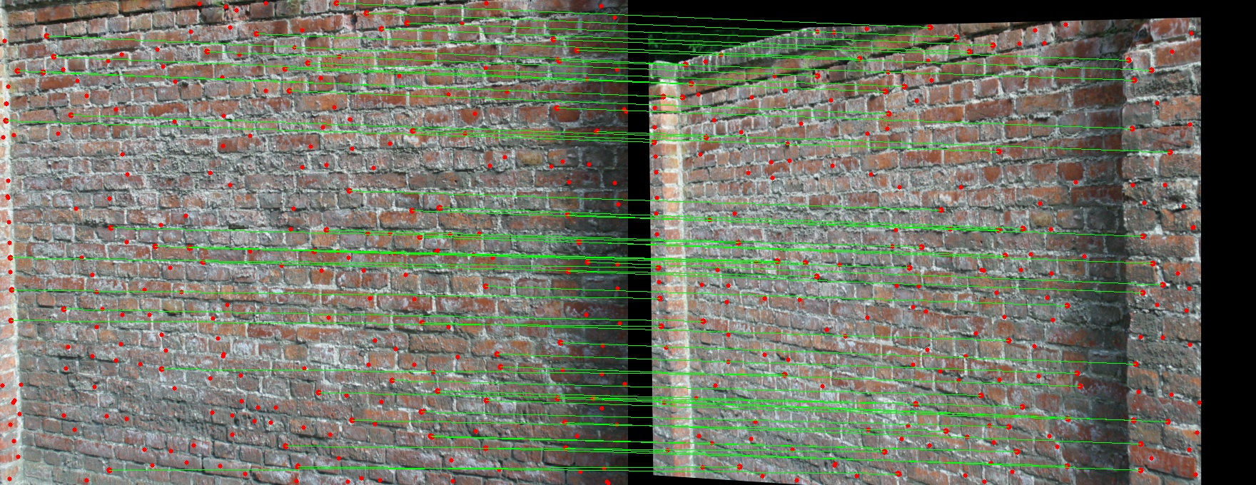
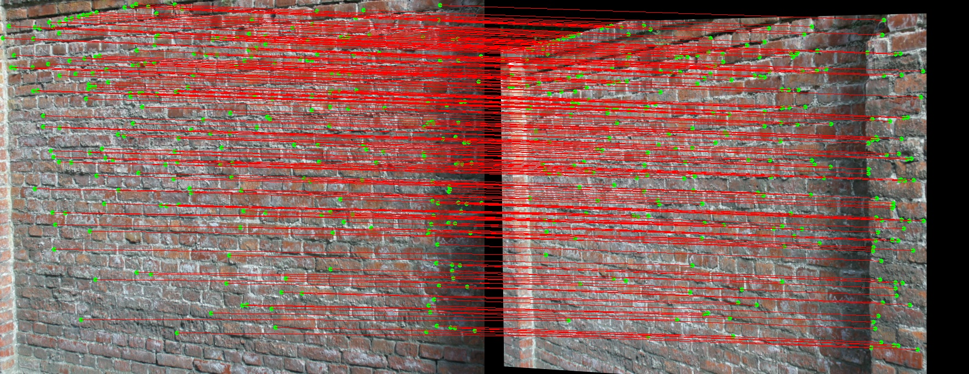
Report 2.3. Feature matching and evaluation-Wall
Specific: H1to2p over img 2 –img 4
𝑯𝒂𝒓𝒎𝒐𝒏𝒊𝒄 𝒎𝒆𝒂𝒏 (All self coded, except basic np. cv2. library)
Using SIFT (involve using a part of cv2.sift library functions)
$$DistThresh$$
$$DistThresh$$
$$NearestMatch$$
$$NearestMatch$$
$$NearestRatio$$
$$NearestRatio$$
* Red Dots are Keypoints, Green Lines are Ture Positive Matches, bad results are not shown (they are Red Dots without matching).
* Green Dots are Keypoints, Red Lines are Ture Positive Matches, bad results are not shown (they are Red Dots without matching).

Slide 18






Report 2.3. Feature matching and evaluation-Wall
Specific: H1to4p over img 2 –img 4
𝑯𝒂𝒓𝒎𝒐𝒏𝒊𝒄 𝒎𝒆𝒂𝒏 (All self coded, except basic np. cv2. library)
Using SIFT (involve using a part of cv2.sift library functions)
$$DistThresh$$
$$DistThresh$$
$$NearestMatch$$
$$NearestMatch$$
$$NearestRatio$$
$$NearestRatio$$
* Red Dots are Keypoints, Green Lines are Ture Positive Matches, bad results are not shown (they are Red Dots without matching).
* Green Dots are Keypoints, Red Lines are Ture Positive Matches, bad results are not shown (they are Red Dots without matching).

Slide 19
Report 2.3. Feature matching and evaluation-Wall
Specific: H1to2p over img 2 –img 4
Specific: H1to4p over img 2 –img 4

Slide 20
Interpretation & Discussion
Bikes
Img 1 – 3
①
This assignment is making hands-on test with feature detection, description, and matching, which are fundamental concepts in computer vision. By implementing the pipeline, we can learn the practical aspects of these concepts and gain insight into how the CV functions work in different scenarios.
The first step of the pipeline involves feature detection using autocorrelation matrices and scalar feature detection measures. This is an important step as it determines which points in the image are likely to be good features for matching. By visualizing the detected feature points, students can gain a better understanding of how the algorithm works and what kind of features are being detected.
The second step of the pipeline involves feature matching and evaluation using a feature descriptor. This is an essential step in many computer vision applications, such as object recognition and image registration. By comparing the performance of different matching strategies and evaluating the results using homography matrices, students can gain an understanding of the strengths and limitations of different feature descriptors and matching algorithms.
Overall, this assignment provides a full pipeline to feature detection, description, and matching in CV. I tried different matching strategies and evaluate their performance, some of them are useful for giving more advanced results.
Leuven
Img 1 – 6
②
Wall
Img 2 – 4
③

